Slide 1


Introduction to Operating Systems CS 1550
Spring 2023
Sherif Khattab
ksm73@pitt.edu
(Some slides are from Silberschatz, Galvin and Gagne ©2013)

Slide 2
Announcements
Upcoming deadlines
Homework 6 is due this Friday
Quiz 1 and Lab 2 due on Tuesday 2/28 at 11:59 pm
Project 2 is due Friday 3/17 at 11:59 pm
Midterm exam on Thursday 3/2
In-person, on paper, closed book
Study guide, old exam, and practice Midterm on Canvas
Lost points because autograder or simple mistake?
please reach out to Grader TA over Piazza
Navigating the Panopto Videos
Video contents
Search in captions

Slide 3
Previous lecture …
Sleepy Barbers solution using Condition Variables

Slide 4
Today …
How to implement condition variables
Reflections on using semaphores and condition variables
CPU Scheduling

Slide 5
User-level implementation of Condition Variables
Why?
Some operating systems don’t have condition variables
Another exercise on solving synchronization problems with semaphores
What are the waiting situations?
waiting to acquire the lock
waiting on the condition variable
waiting after signaling on a condition variable
This is Hoare semantics
signaling process waits
Compare to Mesa semantics
signaled process waits

Slide 6
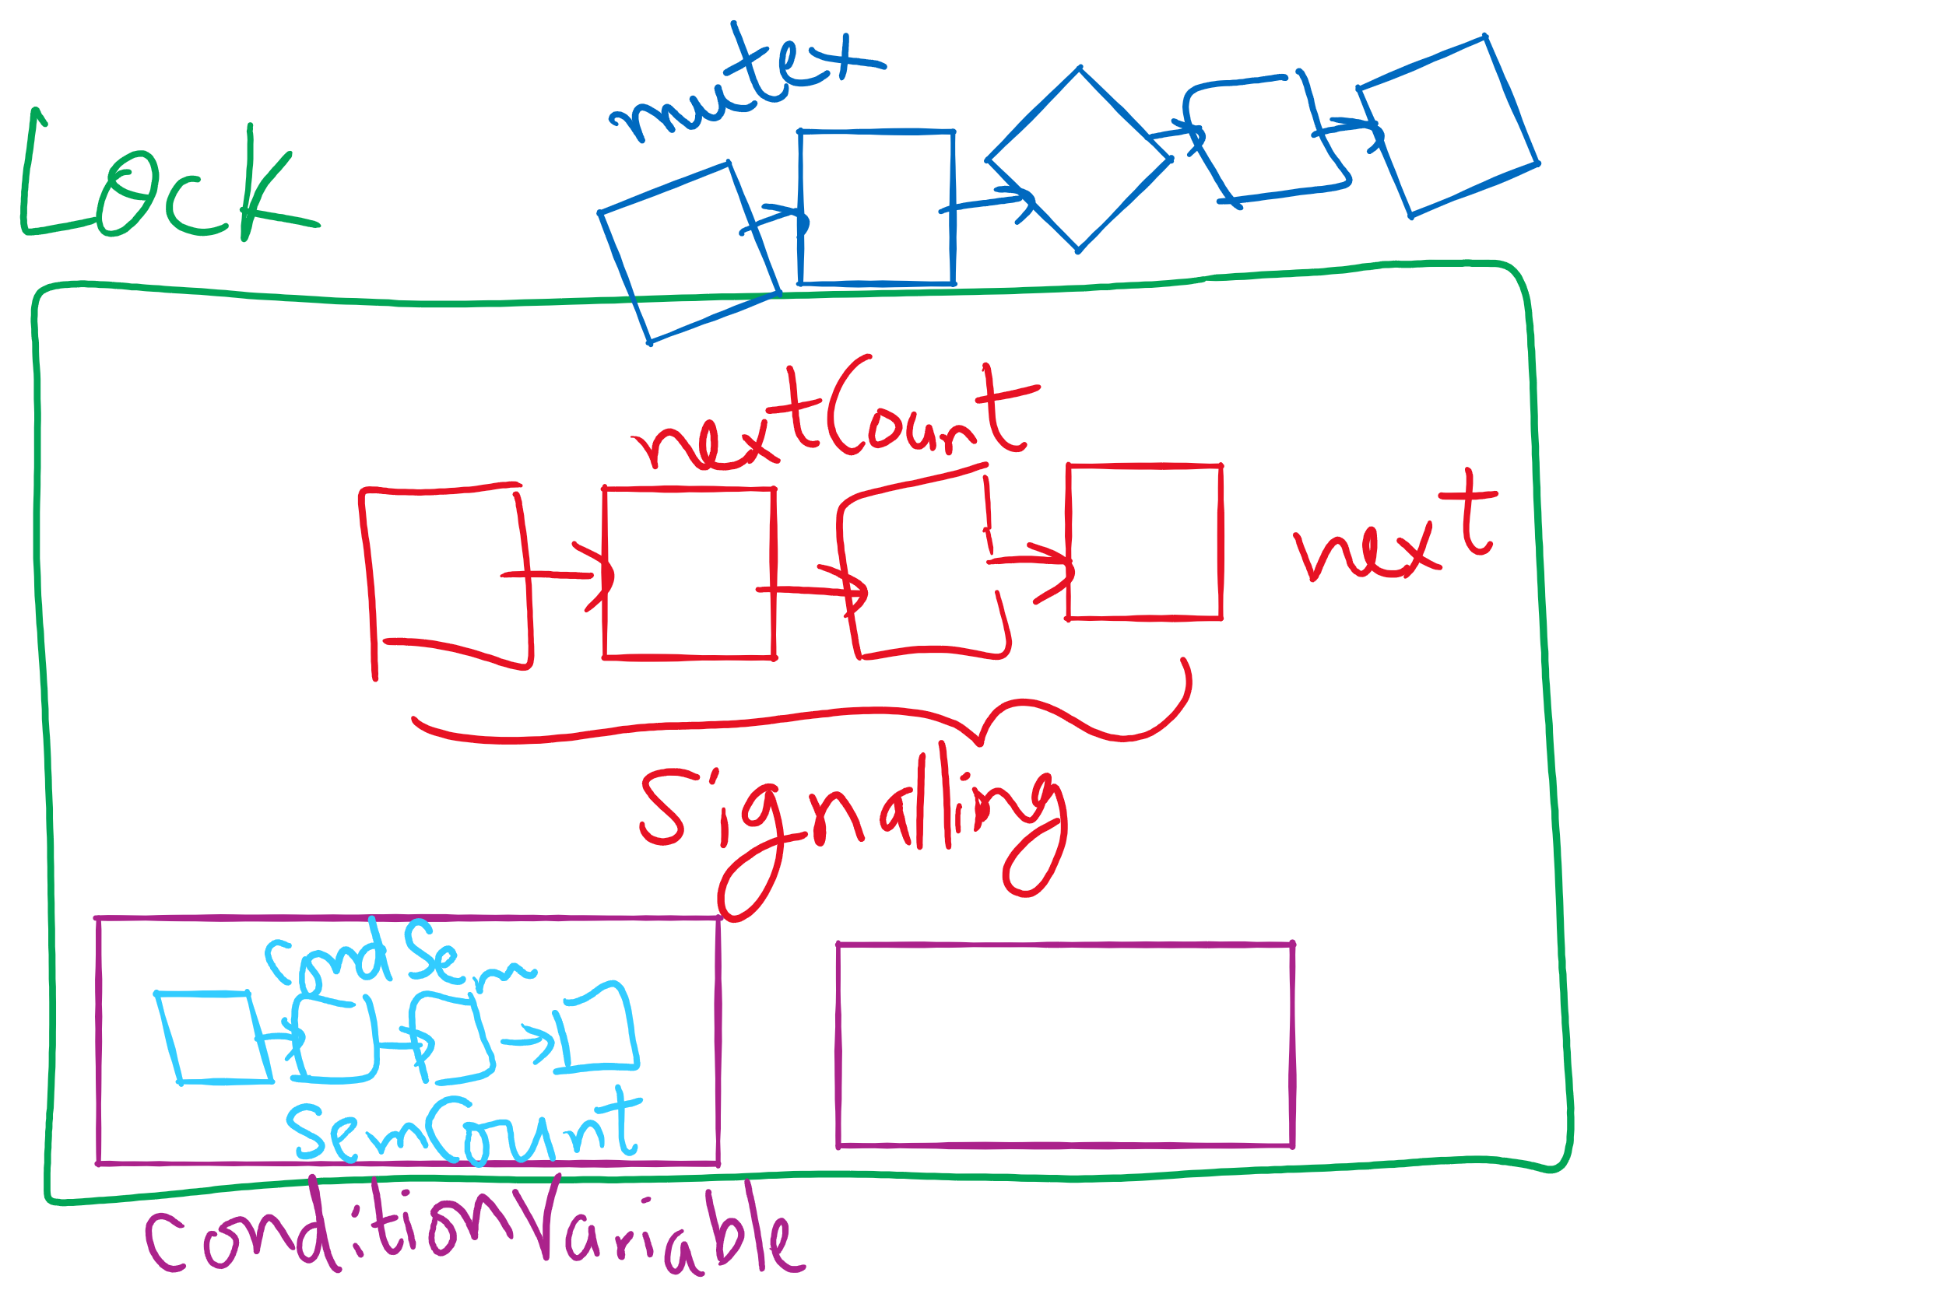
Lock and Condition Variable Implementation

Slide 7
Lock and Condition Variable Implementation
Let’s have a semaphore for each waiting situation

Slide 8
User-level implementation of Condition Variables
A Lock with two waiting queues
struct Lock {
Semaphore mutex(1);
Semaphore next(0);
int nextCount = 0;
}
Acquire(){
mutex.down();
}
Release(){
if(nextCount > 0){
next.up();
nextCount--;
} else mutex.up();
}

Slide 9
Condition Variable
struct ConditionVariable {
Semaphore condSem(0);
int semCount = 0;
Lock *lk;
}
Wait(){
if(lk->nextCount > 0)
lk->next.up();
lk->nextCount--;
else lk->mutex.up();
semCount++;
condSem.down();
semCount--;
}
Signal(){
if(semCount > 0){
condSem.up()
lk->nextCount++
lk->next.down();
lk->nextCount—
}
}

Slide 10
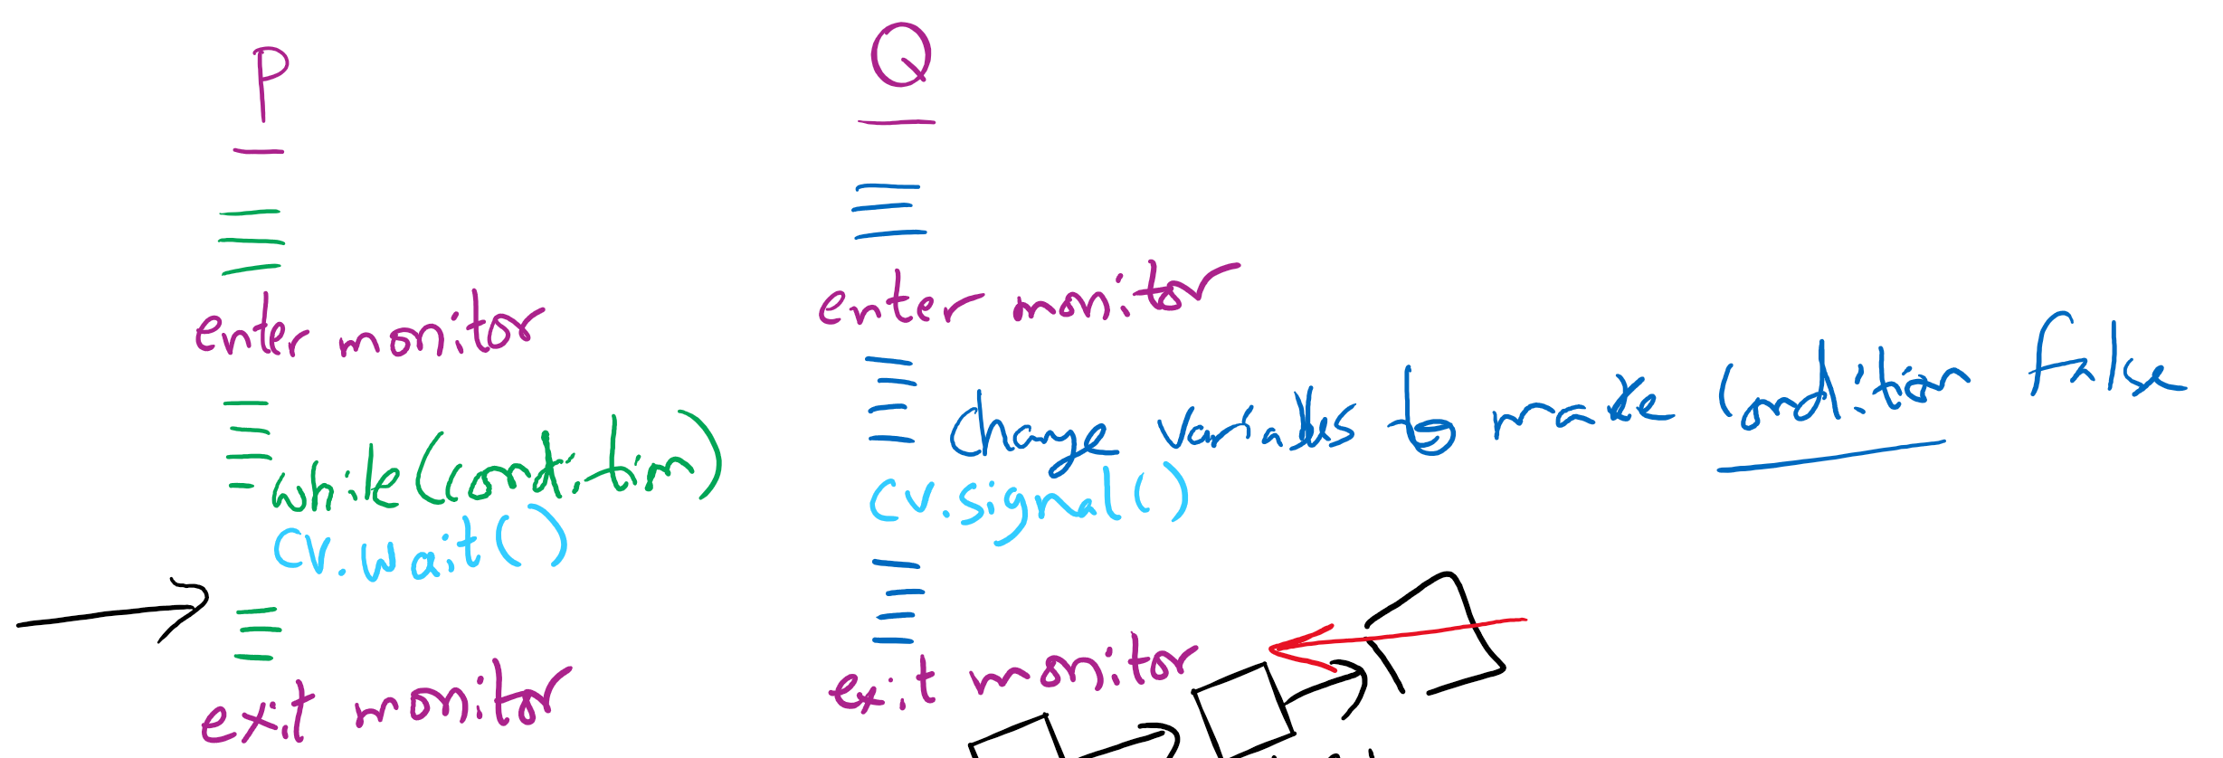
Let’s trace our solution!
Note: Monitor is another name for Lock

Slide 11
Reflections on semaphore usage
Semaphores can be used as
Resource counters
Waiting spaces
For mutual exclusion

Slide 12
Reflections on Condition Variables
Define a class and put all shared variables inside the class
Include a mutex and a condition variable in the class
For each public method of the class
Start by locking the mutex lock
If need to wait, use a while loop and wait on the condition variable
Before broadcasting on the condition variable, make sure to change the waiting condition

Slide 13
Final Remarks on Process Synchronization
Many other synchronization mechanisms
Message passing
Barriers
Futex
Re-entrant locks
AtomicInteger, AtomicX

Slide 14
Problem of the Day: CPU Scheduling
How does the short-term scheduler select the next process to run?

Slide 15
CPU Scheduling
Scheduling the processor among all ready processes
User-oriented criteria
Response Time: Elapsed time between the submission of a request and the receipt of a response
Turnaround Time: Elapsed time between the submission of a process to its completion
System-oriented criteria
Processor utilization
Throughput: number of process completed per unit time
Fairness

Slide 16
Short-Term Scheduler Dispatcher
The dispatcher is the module that gives control of the CPU to the process selected by the short-term scheduler
The functions of the dispatcher include:
Switching context
Switching to user mode
Jumping to the location in the user program to restart execution
The dispatch latency must be minimal

Slide 17





The CPU-I/O Cycle
Processes require alternate use of processor and I/O in a repetitive fashion
Each cycle consist of a CPU burst followed by an I/O burst
A process terminates on a CPU burst
CPU-bound processes have longer CPU bursts than I/O-bound processes

Slide 18
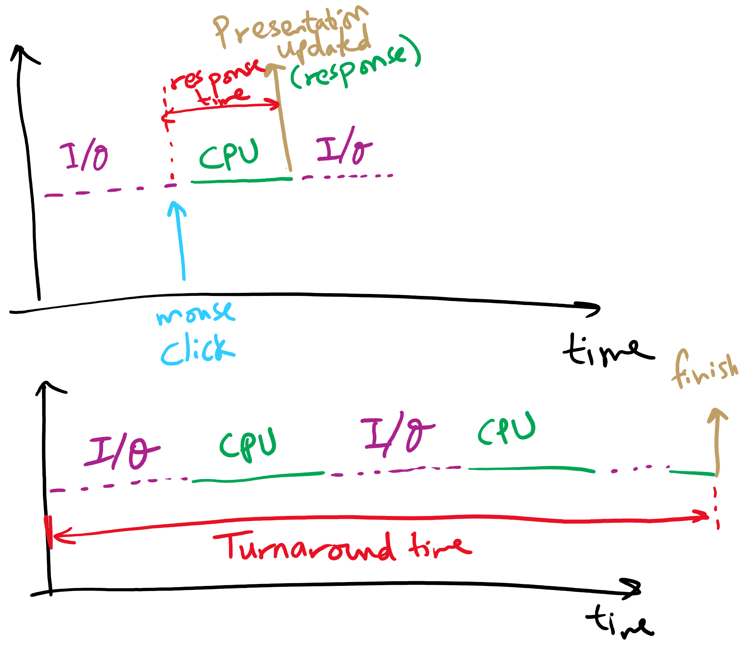
Response time vs. Turnaround time

Slide 19
Scheduling Algorithms
First-Come, First-Served Scheduling
Shortest-Job-First Scheduling
Also referred to as Shortest Process Next
Priority Scheduling
Round-Robin Scheduling
Multilevel Queue Scheduling
Multilevel Feedback Queue Scheduling

Slide 20
Characterization of Scheduling Policies
The selection function determines which ready process is selected next for execution
The decision mode specifies the instants in time the selection function is exercised
Nonpreemptive
Once a process is in the running state, it will continue until it terminates or blocks for an I/O
Preemptive
Currently running process may be interrupted and moved to the Ready state by the OS
Prevents one process from monopolizing the processor

Slide 21
Process Mix Example
Process
Arrival Time
Service Time
1
0
3
2
2
6
3
4
4
4
6
5
5
8
2
Service time = total processor time needed in one (CPU-I/O) cycle
Jobs with long service time are CPU-bound jobs and are referred
to as “long jobs”

Slide 22







First Come First Served (FCFS)
Selection function: the process that has been waiting the longest in the ready queue (hence, FCFS)
Decision mode: non-preemptive
a process runs until it blocks for an I/O
Process
Arrival Time
Service Time
1
0
3
2
2
6
3
4
4
4
6
5
5
8
2

Slide 23
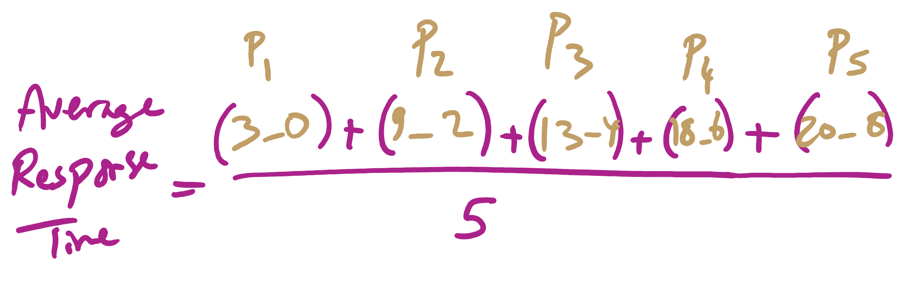
Average Response Time

Slide 24
FCFS drawbacks
Favours CPU-bound processes
CPU-bound processes monopolize the processor
I/O-bound processes have to wait until completion of CPU-bound process
I/O-bound processes may have to wait even after their I/Os are completed (poor device utilization)
Convoy effect
Better I/O device utilization could be achieved if I/O bound processes had higher priority

Slide 25
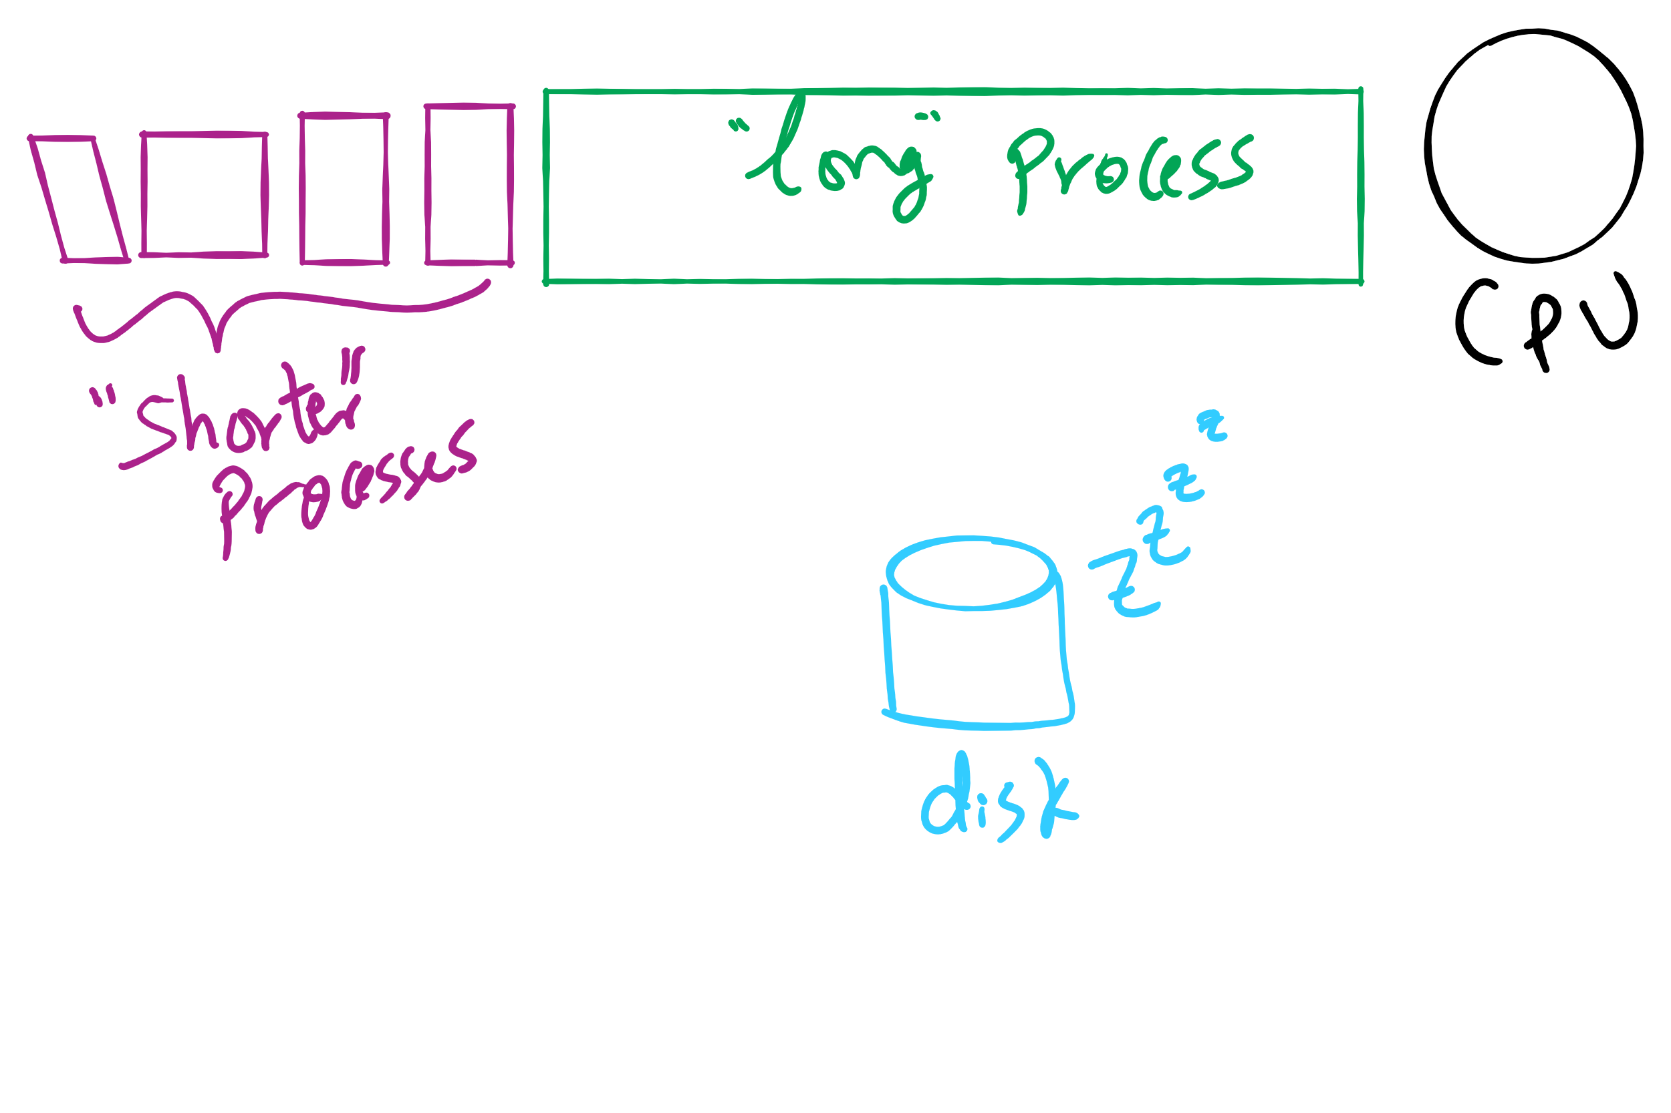
Convoy Effect

Slide 26











Shortest Job First (Shortest Process Next)
Selection function: the process with the shortest expected CPU burst time
I/O-bound processes will be selected first
Decision mode: non-preemptive
The required processing time, i.e., the CPU burst time, must be estimated for each process
Process
Arrival Time
Service Time
1
0
3
2
2
6
3
4
4
4
6
5
5
8
2

Slide 27
SJF / SPN Critique
Possibility of starvation for longer processes
Lack of preemption is not suitable in a time sharing environment
SJF/SPN implicitly incorporates priorities
Shortest jobs are given preference
CPU bound processes have lower priority, but a process doing no I/O could still monopolize the CPU if it is the first to enter the system

Slide 28
Priorities
Implemented by having multiple ready queues to represent each level of priority
Scheduler selects the process of a higher priority over one of lower priority
Lower-priority may suffer starvation
To alleviate starvation allow dynamic priorities
The priority of a process changes based on its age or execution history

Slide 29
Round-Robin
Selection function: same as FCFS
Decision mode: pre-emptive
a process is allowed to run until the time slice period (quantum, typically from 10 to 100 ms) has expired
a clock interrupt occurs and the running process is put on the ready queue
Process
Arrival Time
Service Time
1
0
3
2
2
6
3
4
4
4
6
5
5
8
2

Slide 30

Round-Robin
Selection function: same as FCFS
Decision mode: pre-emptive
a process is allowed to run until the time slice period (quantum, typically from 10 to 100 ms) has expired
a clock interrupt occurs and the running process is put on the ready queue
Process
Arrival Time
Service Time
1
0
3
2
2
6
3
4
4
4
6
5
5
8
2

Slide 31

Round-Robin
Selection function: same as FCFS
Decision mode: pre-emptive
a process is allowed to run until the time slice period (quantum, typically from 10 to 100 ms) has expired
a clock interrupt occurs and the running process is put on the ready queue
Process
Arrival Time
Service Time
1
0
3
2
2
6
3
4
4
4
6
5
5
8
2

Slide 32

Round-Robin
Selection function: same as FCFS
Decision mode: pre-emptive
a process is allowed to run until the time slice period (quantum, typically from 10 to 100 ms) has expired
a clock interrupt occurs and the running process is put on the ready queue
Process
Arrival Time
Service Time
1
0
3
2
2
6
3
4
4
4
6
5
5
8
2

Slide 33


Round-Robin
Selection function: same as FCFS
Decision mode: pre-emptive
a process is allowed to run until the time slice period (quantum, typically from 10 to 100 ms) has expired
a clock interrupt occurs and the running process is put on the ready queue
Process
Arrival Time
Service Time
1
0
3
2
2
6
3
4
4
4
6
5
5
8
2

Slide 34

Round-Robin
Selection function: same as FCFS
Decision mode: pre-emptive
a process is allowed to run until the time slice period (quantum, typically from 10 to 100 ms) has expired
a clock interrupt occurs and the running process is put on the ready queue
Process
Arrival Time
Service Time
1
0
3
2
2
6
3
4
4
4
6
5
5
8
2

Slide 35

Round-Robin
Selection function: same as FCFS
Decision mode: pre-emptive
a process is allowed to run until the time slice period (quantum, typically from 10 to 100 ms) has expired
a clock interrupt occurs and the running process is put on the ready queue
Process
Arrival Time
Service Time
1
0
3
2
2
6
3
4
4
4
6
5
5
8
2

Slide 36

Round-Robin
Selection function: same as FCFS
Decision mode: pre-emptive
a process is allowed to run until the time slice period (quantum, typically from 10 to 100 ms) has expired
a clock interrupt occurs and the running process is put on the ready queue
Process
Arrival Time
Service Time
1
0
3
2
2
6
3
4
4
4
6
5
5
8
2

Slide 37


Round-Robin
Selection function: same as FCFS
Decision mode: pre-emptive
a process is allowed to run until the time slice period (quantum, typically from 10 to 100 ms) has expired
a clock interrupt occurs and the running process is put on the ready queue
Process
Arrival Time
Service Time
1
0
3
2
2
6
3
4
4
4
6
5
5
8
2

Slide 38

Round-Robin
Selection function: same as FCFS
Decision mode: pre-emptive
a process is allowed to run until the time slice period (quantum, typically from 10 to 100 ms) has expired
a clock interrupt occurs and the running process is put on the ready queue
Process
Arrival Time
Service Time
1
0
3
2
2
6
3
4
4
4
6
5
5
8
2

Slide 39


Round-Robin
Selection function: same as FCFS
Decision mode: pre-emptive
a process is allowed to run until the time slice period (quantum, typically from 10 to 100 ms) has expired
a clock interrupt occurs and the running process is put on the ready queue
Process
Arrival Time
Service Time
1
0
3
2
2
6
3
4
4
4
6
5
5
8
2

Slide 40


Round-Robin
Selection function: same as FCFS
Decision mode: pre-emptive
a process is allowed to run until the time slice period (quantum, typically from 10 to 100 ms) has expired
a clock interrupt occurs and the running process is put on the ready queue
Process
Arrival Time
Service Time
1
0
3
2
2
6
3
4
4
4
6
5
5
8
2

Slide 41

Round-Robin
Selection function: same as FCFS
Decision mode: pre-emptive
a process is allowed to run until the time slice period (quantum, typically from 10 to 100 ms) has expired
a clock interrupt occurs and the running process is put on the ready queue
Process
Arrival Time
Service Time
1
0
3
2
2
6
3
4
4
4
6
5
5
8
2

Slide 42

Round-Robin
Selection function: same as FCFS
Decision mode: pre-emptive
a process is allowed to run until the time slice period (quantum, typically from 10 to 100 ms) has expired
a clock interrupt occurs and the running process is put on the ready queue
Process
Arrival Time
Service Time
1
0
3
2
2
6
3
4
4
4
6
5
5
8
2

Slide 43


Round-Robin
Selection function: same as FCFS
Decision mode: pre-emptive
a process is allowed to run until the time slice period (quantum, typically from 10 to 100 ms) has expired
a clock interrupt occurs and the running process is put on the ready queue
Process
Arrival Time
Service Time
1
0
3
2
2
6
3
4
4
4
6
5
5
8
2

Slide 44

Round-Robin
Selection function: same as FCFS
Decision mode: pre-emptive
a process is allowed to run until the time slice period (quantum, typically from 10 to 100 ms) has expired
a clock interrupt occurs and the running process is put on the ready queue
Process
Arrival Time
Service Time
1
0
3
2
2
6
3
4
4
4
6
5
5
8
2

Slide 45

Round-Robin
Selection function: same as FCFS
Decision mode: pre-emptive
a process is allowed to run until the time slice period (quantum, typically from 10 to 100 ms) has expired
a clock interrupt occurs and the running process is put on the ready queue
Process
Arrival Time
Service Time
1
0
3
2
2
6
3
4
4
4
6
5
5
8
2

Slide 46


Round-Robin
Selection function: same as FCFS
Decision mode: pre-emptive
a process is allowed to run until the time slice period (quantum, typically from 10 to 100 ms) has expired
a clock interrupt occurs and the running process is put on the ready queue
Process
Arrival Time
Service Time
1
0
3
2
2
6
3
4
4
4
6
5
5
8
2

Slide 47

Round-Robin
Selection function: same as FCFS
Decision mode: pre-emptive
a process is allowed to run until the time slice period (quantum, typically from 10 to 100 ms) has expired
a clock interrupt occurs and the running process is put on the ready queue
Process
Arrival Time
Service Time
1
0
3
2
2
6
3
4
4
4
6
5
5
8
2

Slide 48
RR Time Quantum
Quantum must be substantially larger than the time required to handle the clock interrupt and dispatching
Quantum should be larger then the typical interaction
but not much larger, to avoid penalizing I/O bound processes

Slide 49
RR Time Quantum

Slide 50
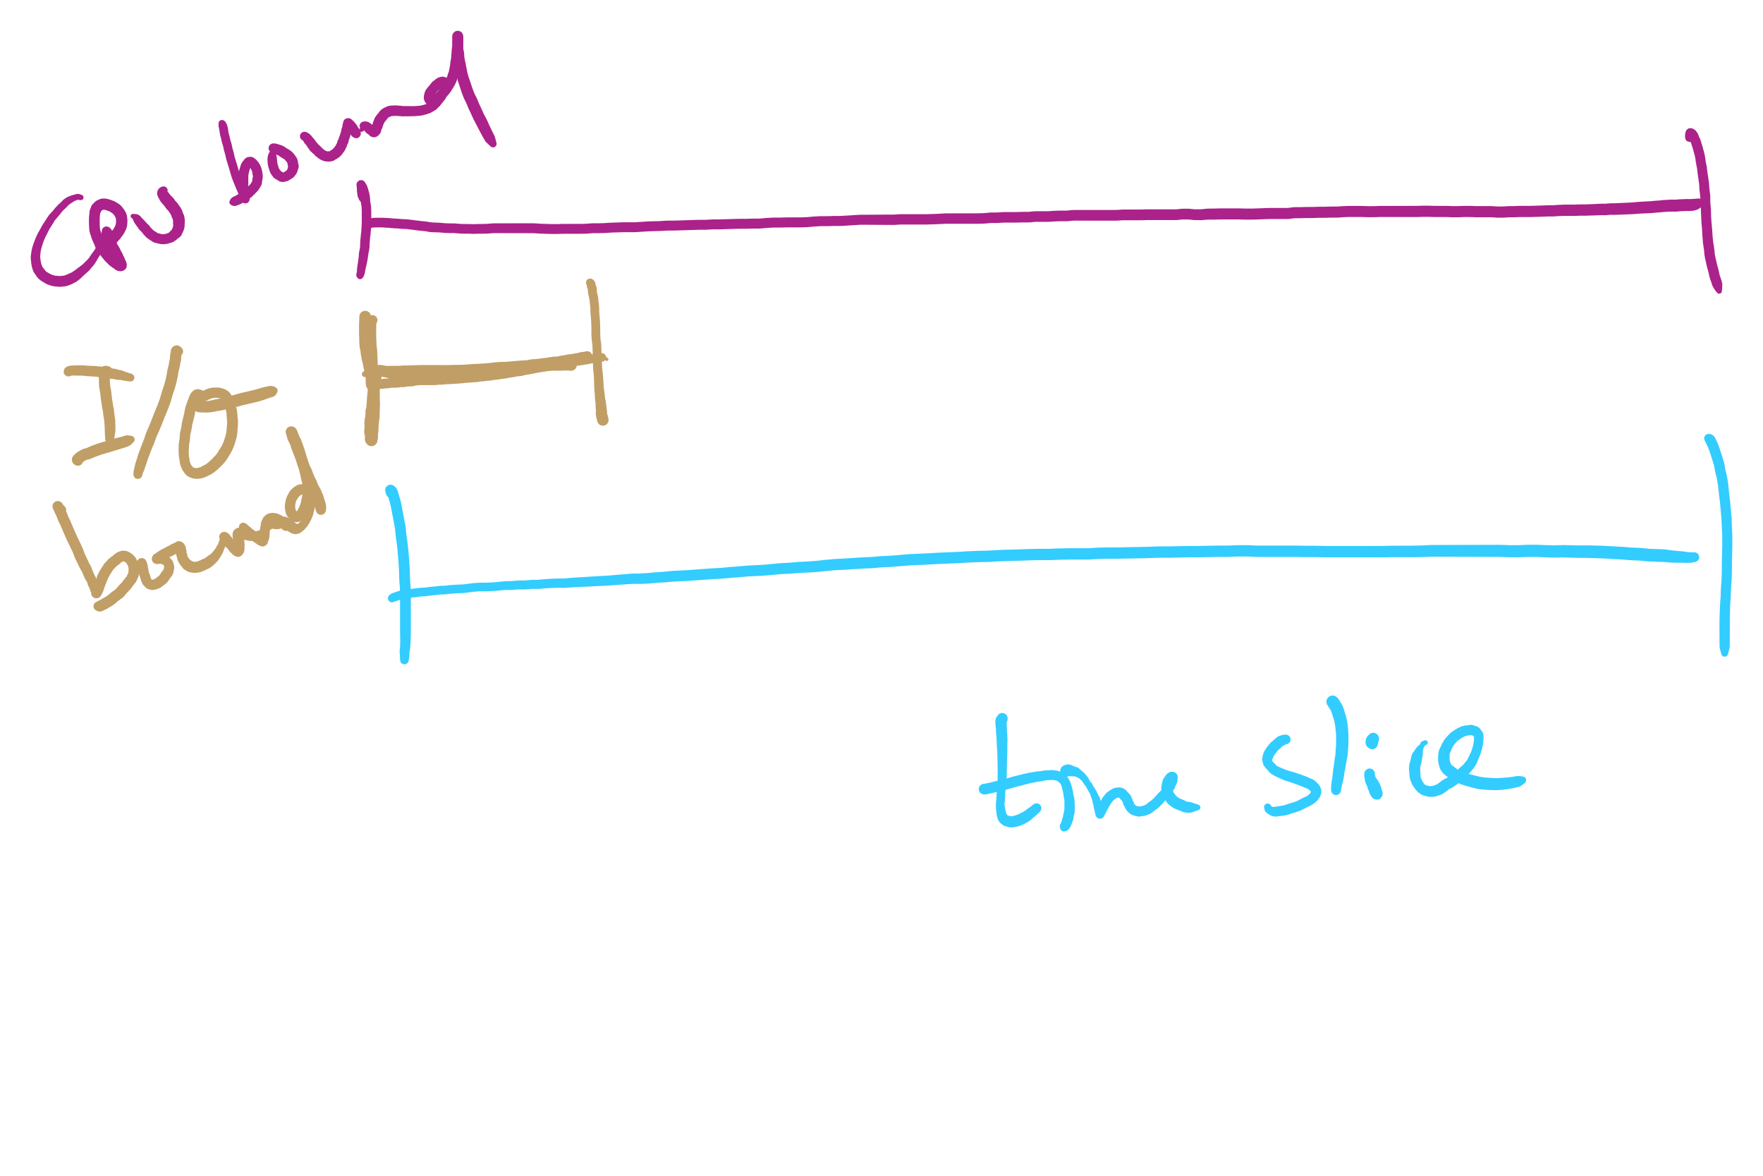
Quantum Length

Slide 51
Round Robin: critique
Still favors CPU-bound processes
An I/O bound process uses the CPU for a time less than the time quantum before it is blocked waiting for an I/O
A CPU-bound process runs for all its time slice and is put back into the ready queue
May unfairly get in front of blocked processes

Slide 52
Multilevel Feedback Scheduling
Preemptive scheduling with dynamic priorities
N ready to execute queues with decreasing priorities:
P(RQ₀) > P(RQ₁) > ... > P(RQ_{N-1})
Dispatcher selects a process for execution from RQ_{i} only if RQ_{i-1} to RQ₀ are empty

Slide 53
Multilevel Feedback Scheduling
New process are placed in RQ₀
After the first quantum, they are moved to RQ₁, and to RQ₂ after the second quantum, … and to RQ_{N-1} after the Nth quantum
I/O-bound processes remain in higher priority queues.
CPU-bound jobs drift downward.
Hence, long jobs may starve

Slide 54
Multiple Feedback Queues
Different RQs may have different quantum values

Slide 55
Time Quantum for feedback Scheduling
With a fixed quantum time, the turn-around time of longer processes can be high
To alleviate this problem, the time quantum can be increased based on the depth of the queue
Time quantum of RQ_{i} = 2^{i-1}
May still cause longer processes to suffer starvation.
Possible fix is to promote a process to higher queue after some time
Process
Arrival Time
Service Time
1
0
3
2
2
6
3
4
4
4
6
5
5
8
2

Slide 56

Time Quantum for feedback Scheduling
With a fixed quantum time, the turn-around time of longer processes can be high
To alleviate this problem, the time quantum can be increased based on the depth of the queue
Time quantum of RQ_{i} = 2^{i-1}
May still cause longer processes to suffer starvation.
Possible fix is to promote a process to higher queue after some time
Process
Arrival Time
Service Time
1
0
3
2
2
6
3
4
4
4
6
5
5
8
2

Slide 57

Time Quantum for feedback Scheduling
With a fixed quantum time, the turn-around time of longer processes can be high
To alleviate this problem, the time quantum can be increased based on the depth of the queue
Time quantum of RQ_{i} = 2^{i-1}
May still cause longer processes to suffer starvation.
Possible fix is to promote a process to higher queue after some time
Process
Arrival Time
Service Time
1
0
3
2
2
6
3
4
4
4
6
5
5
8
2

Slide 58

Time Quantum for feedback Scheduling
With a fixed quantum time, the turn-around time of longer processes can be high
To alleviate this problem, the time quantum can be increased based on the depth of the queue
Time quantum of RQ_{i} = 2^{i-1}
May still cause longer processes to suffer starvation.
Possible fix is to promote a process to higher queue after some time
Process
Arrival Time
Service Time
1
0
3
2
2
6
3
4
4
4
6
5
5
8
2

Slide 59

Time Quantum for feedback Scheduling
With a fixed quantum time, the turn-around time of longer processes can be high
To alleviate this problem, the time quantum can be increased based on the depth of the queue
Time quantum of RQ_{i} = 2^{i-1}
May still cause longer processes to suffer starvation.
Possible fix is to promote a process to higher queue after some time
Process
Arrival Time
Service Time
1
0
3
2
2
6
3
4
4
4
6
5
5
8
2

Slide 60

Time Quantum for feedback Scheduling
With a fixed quantum time, the turn-around time of longer processes can be high
To alleviate this problem, the time quantum can be increased based on the depth of the queue
Time quantum of RQ_{i} = 2^{i-1}
May still cause longer processes to suffer starvation.
Possible fix is to promote a process to higher queue after some time
Process
Arrival Time
Service Time
1
0
3
2
2
6
3
4
4
4
6
5
5
8
2

Slide 61


Time Quantum for feedback Scheduling
With a fixed quantum time, the turn-around time of longer processes can be high
To alleviate this problem, the time quantum can be increased based on the depth of the queue
Time quantum of RQ_{i} = 2^{i-1}
May still cause longer processes to suffer starvation.
Possible fix is to promote a process to higher queue after some time
Process
Arrival Time
Service Time
1
0
3
2
2
6
3
4
4
4
6
5
5
8
2

Slide 62


Time Quantum for feedback Scheduling
With a fixed quantum time, the turn-around time of longer processes can be high
To alleviate this problem, the time quantum can be increased based on the depth of the queue
Time quantum of RQ_{i} = 2^{i-1}
May still cause longer processes to suffer starvation.
Possible fix is to promote a process to higher queue after some time
Process
Arrival Time
Service Time
1
0
3
2
2
6
3
4
4
4
6
5
5
8
2

Slide 63

Time Quantum for feedback Scheduling
With a fixed quantum time, the turn-around time of longer processes can be high
To alleviate this problem, the time quantum can be increased based on the depth of the queue
Time quantum of RQ_{i} = 2^{i-1}
May still cause longer processes to suffer starvation.
Possible fix is to promote a process to higher queue after some time
Process
Arrival Time
Service Time
1
0
3
2
2
6
3
4
4
4
6
5
5
8
2

Slide 64

Time Quantum for feedback Scheduling
With a fixed quantum time, the turn-around time of longer processes can be high
To alleviate this problem, the time quantum can be increased based on the depth of the queue
Time quantum of RQ_{i} = 2^{i-1}
May still cause longer processes to suffer starvation.
Possible fix is to promote a process to higher queue after some time
Process
Arrival Time
Service Time
1
0
3
2
2
6
3
4
4
4
6
5
5
8
2

Slide 65

Time Quantum for feedback Scheduling
With a fixed quantum time, the turn-around time of longer processes can be high
To alleviate this problem, the time quantum can be increased based on the depth of the queue
Time quantum of RQ_{i} = 2^{i-1}
May still cause longer processes to suffer starvation.
Possible fix is to promote a process to higher queue after some time
Process
Arrival Time
Service Time
1
0
3
2
2
6
3
4
4
4
6
5
5
8
2

Slide 66

Time Quantum for feedback Scheduling
With a fixed quantum time, the turn-around time of longer processes can be high
To alleviate this problem, the time quantum can be increased based on the depth of the queue
Time quantum of RQ_{i} = 2^{i-1}
May still cause longer processes to suffer starvation.
Possible fix is to promote a process to higher queue after some time
Process
Arrival Time
Service Time
1
0
3
2
2
6
3
4
4
4
6
5
5
8
2

Slide 67

Time Quantum for feedback Scheduling
With a fixed quantum time, the turn-around time of longer processes can be high
To alleviate this problem, the time quantum can be increased based on the depth of the queue
Time quantum of RQ_{i} = 2^{i-1}
May still cause longer processes to suffer starvation.
Possible fix is to promote a process to higher queue after some time
Process
Arrival Time
Service Time
1
0
3
2
2
6
3
4
4
4
6
5
5
8
2

Slide 68

Time Quantum for feedback Scheduling
With a fixed quantum time, the turn-around time of longer processes can be high
To alleviate this problem, the time quantum can be increased based on the depth of the queue
Time quantum of RQ_{i} = 2^{i-1}
May still cause longer processes to suffer starvation.
Possible fix is to promote a process to higher queue after some time
Process
Arrival Time
Service Time
1
0
3
2
2
6
3
4
4
4
6
5
5
8
2

Slide 69
Algorithm Comparison
Which one is the best?
The answer depends on many factors:
the system workload (extremely variable)
hardware support for the dispatcher
relative importance of performance criteria (response time, CPU utilization, throughput...)
The evaluation method used (each has its limitations...)

Slide 70
Back to SJF: CPU Burst Estimation
Let T[i] be the execution time for the ith instance of this process: the actual duration of the ith CPU burst of this process
Let S[i] be the predicted value for the ith CPU burst of this process. The simplest choice is:
S[n+1] =(1/n)(T[1]+…+T[n])=(1/n) Σ{i=1 to n} T[i]
This can be more efficiently calculated as:
S[n+1] = (1/n) T[n] + ((n-1)/n) S[n]
This estimate, however, results in equal weight for each instance

Slide 71
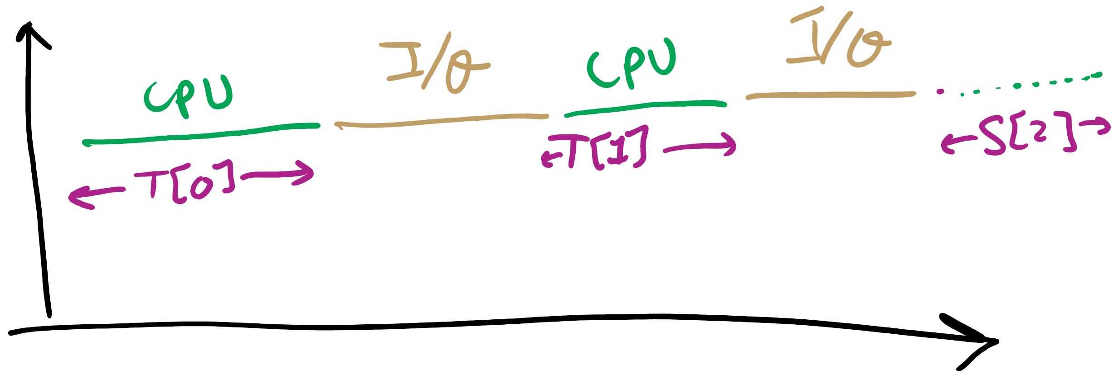
CPU Burst Estimation

Slide 72
Estimating the required CPU burst
Recent instances are more likely to better reflect future behavior
A common technique to factor the above observation into the estimate is to use exponential averaging :
S[n+1] = α T[n] + (1- α) S[n] ; 0 < α < 1

Slide 73
CPU burst Estimate (Exponential Average)
Recent instances have higher weights, whenever α > 1/n
Expanding the estimated value shows that the weights of past instances decrease exponentially
S[n+1] = α T[n] + (1- α) α T[n-1] + ... (1- α)^{i} α T[n-i] +
... + (1- α)^{n}S[1]
The predicted value of 1st instance, S[1], is usually set to 0 to give priority to new processes

Slide 74
Exponentially Decreasing Coefficients

Slide 75
Exponentially Decreasing Coefficients
S[1] = 0 to give high priority to new processes
Exponential averaging tracks changes in process behavior much faster than simple averaging

Slide 76
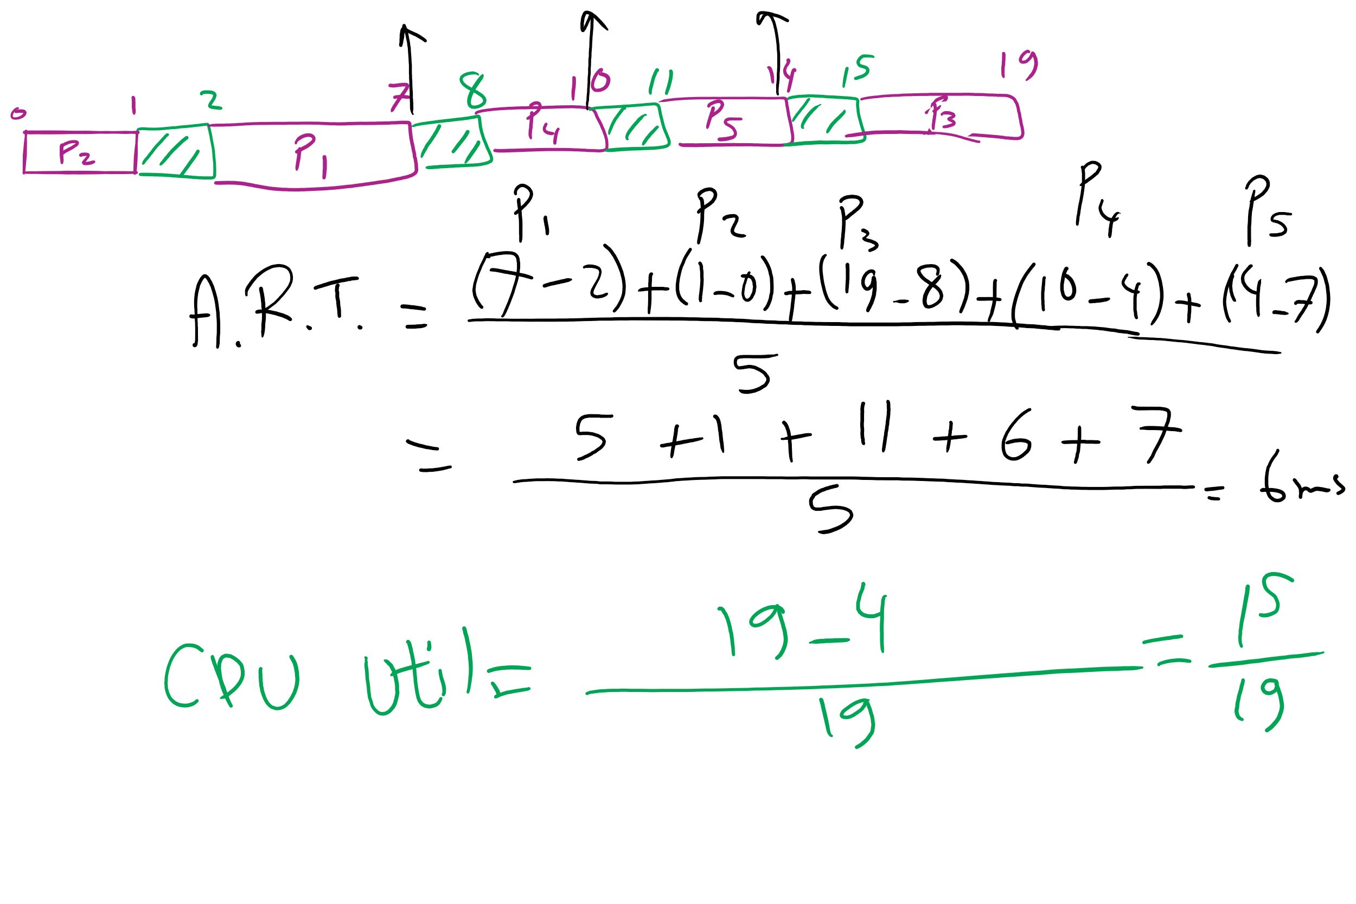
FCFS Problem in HW7

Slide 77
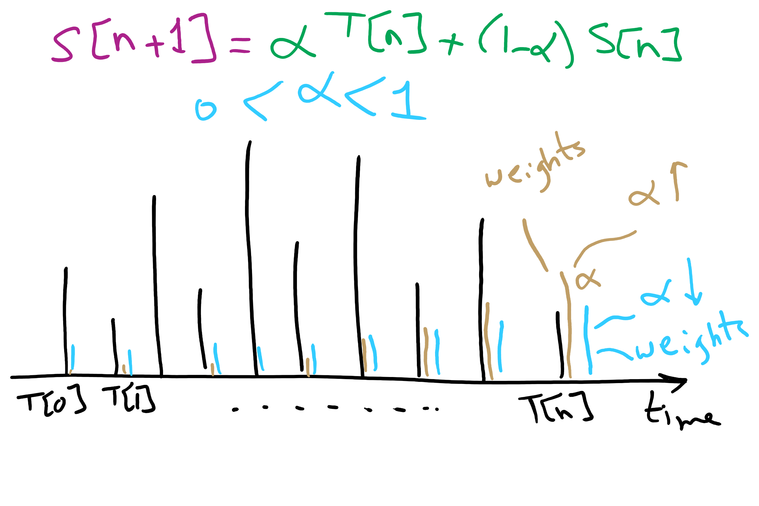
CPU Burst Estimation

